Slide 1
Web-scraping Project
Easha Tu Razia

Slide 2
Aircraft models
Preliminary design of an aircraft consists heuristic approximations.
More organized data can improve the design process.

Slide 3
The Data sources
Airliners
https://www.airliners.net/aircraft-data
Aircraft bluebook
https://aircraftbluebook.com/Tools/ABB/ShowSpecifications.do
Eurocontrol - Contentzone
https://contentzone.eurocontrol.int/aircraftperformance/default.aspx?
Scraped Using Selenium

Slide 4
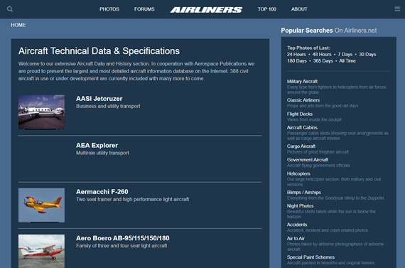
The Data sources
Airliners
https://www.airliners.net/aircraft-data
Aircraft bluebook
https://aircraftbluebook.com/Tools/ABB/ShowSpecifications.do
Eurocontrol - Contentzone
https://contentzone.eurocontrol.int/aircraftperformance/default.aspx?
No. of Data Entries | 400
No. of Features | 15

Slide 5
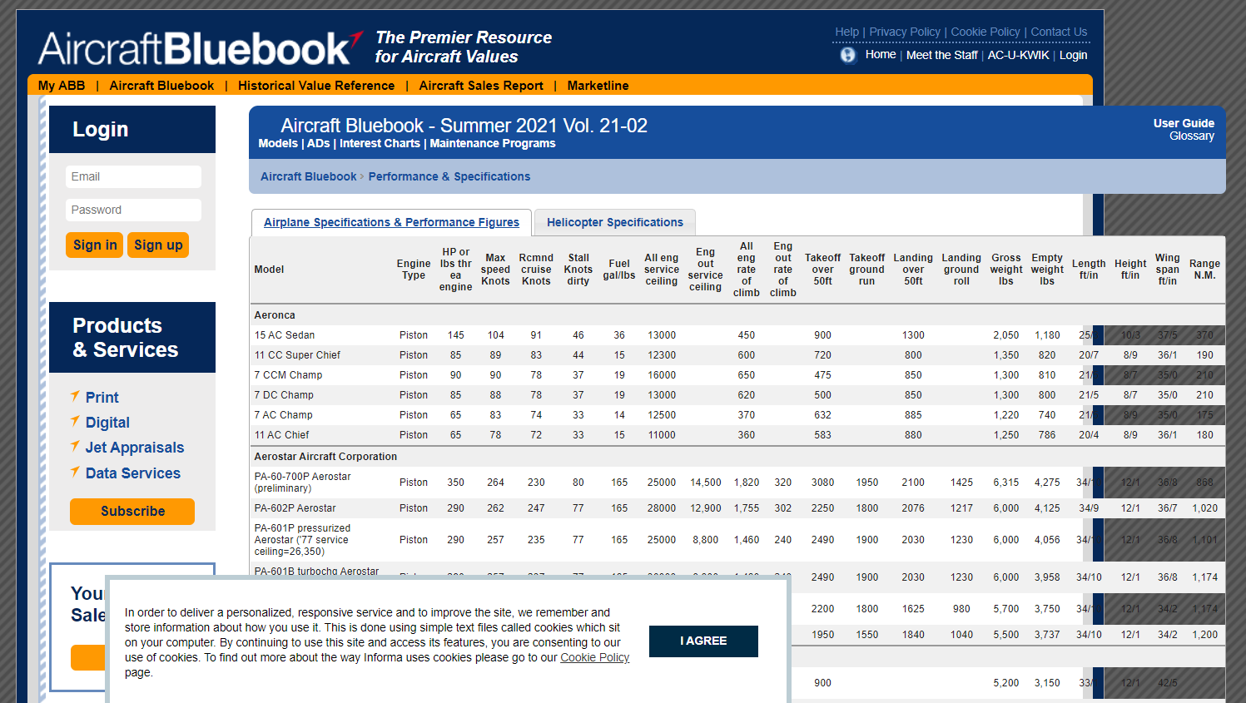
The Data sources
Airliners
https://www.airliners.net/aircraft-data
Aircraft bluebook
https://aircraftbluebook.com/Tools/ABB/ShowSpecifications.do
Eurocontrol - Contentzone
https://contentzone.eurocontrol.int/aircraftperformance/default.aspx?
No. of Data Entries | 820
No. of Features | 22

Slide 6
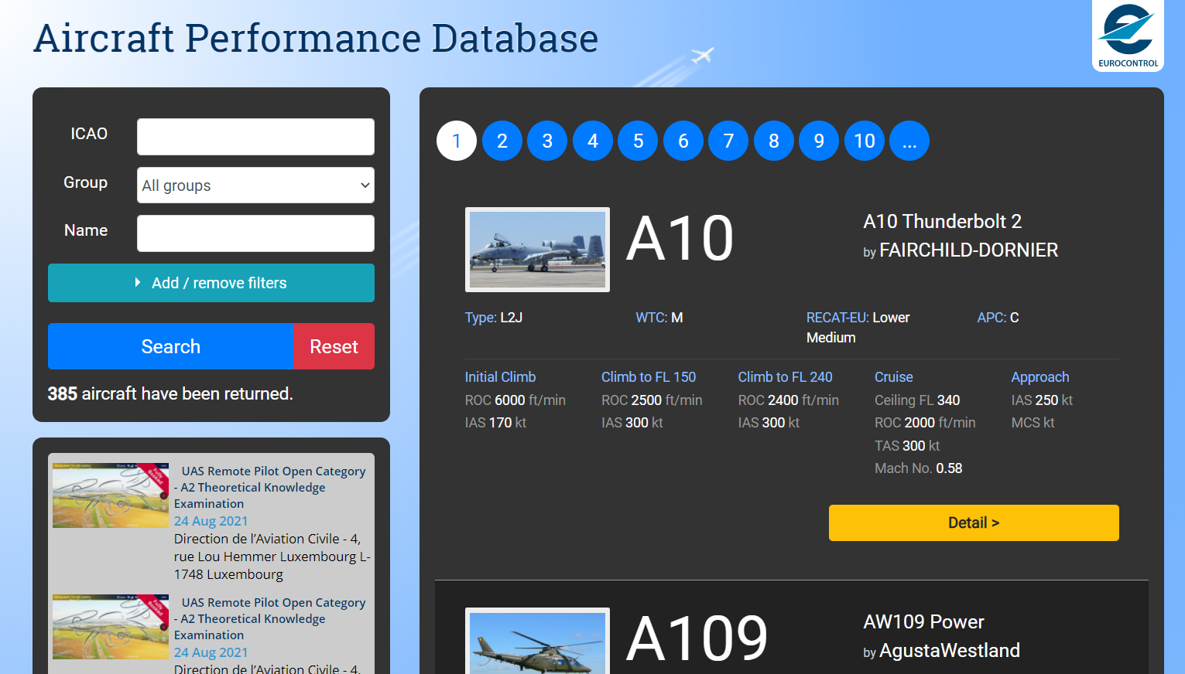
The Data sources
Airliners
https://www.airliners.net/aircraft-data
Aircraft bluebook
https://aircraftbluebook.com/Tools/ABB/ShowSpecifications.do
Eurocontrol - Contentzone
https://contentzone.eurocontrol.int/aircraftperformance/default.aspx?
No. of Data Entries | 385
No. of Features | 18

Slide 7
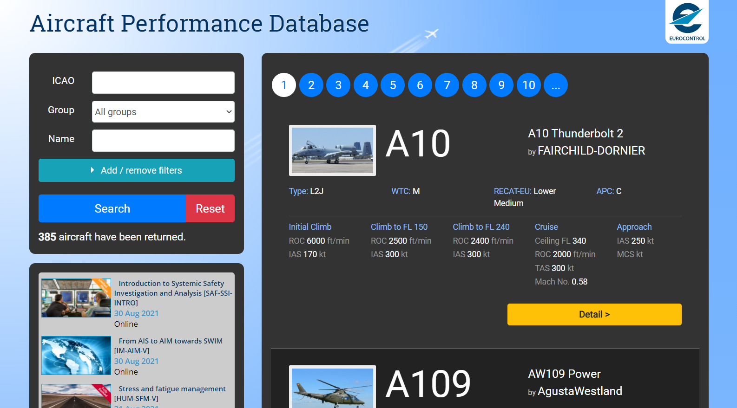
The Scraping
Loop through all pages
Store the UNIQUE identifier to loop through information
Collect Relevant data

Slide 8
The Scraping
https://contentzone.eurocontrol.int/aircraftperformance/details.aspx?ICAO=A10
Loop through all index pages
Store the UNIQUE identifier to loop through information
Collect Relevant data

Slide 9
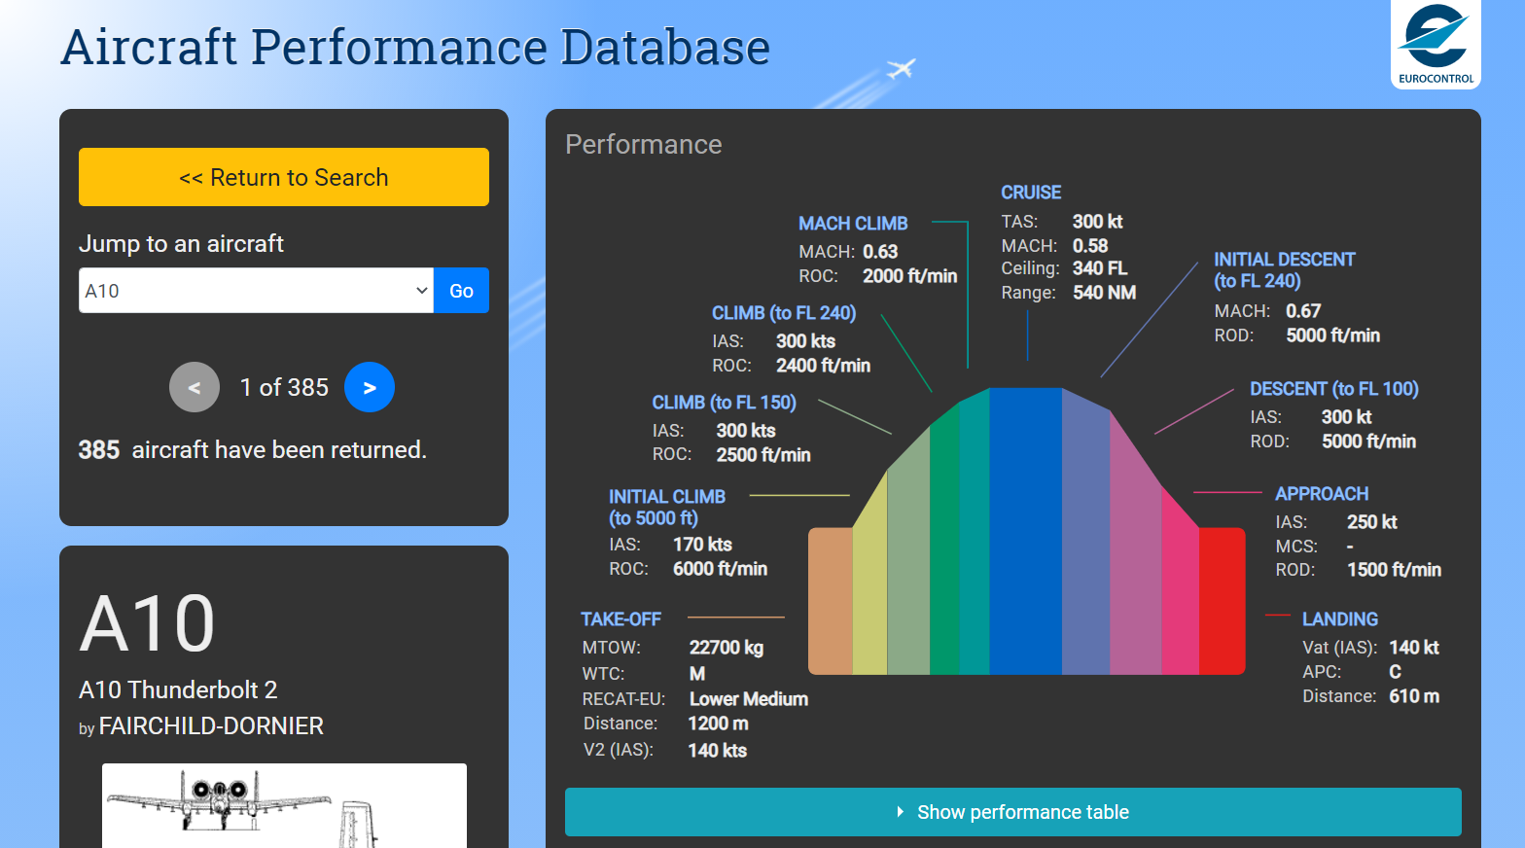
The Scraping
Loop through all index pages
Store the UNIQUE identifier to loop through information
Collect Relevant data

Slide 10
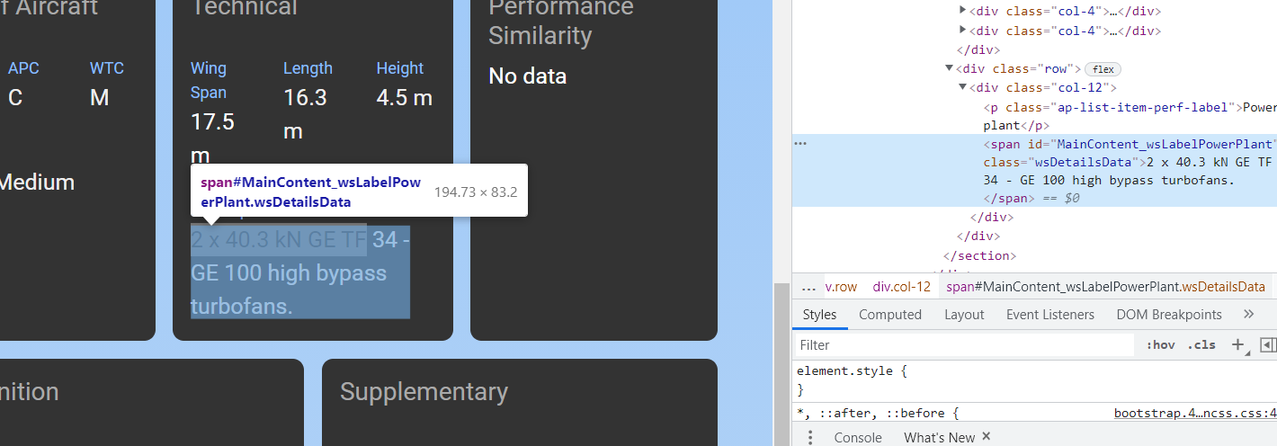
The Scraping
Loop through all index pages
Store the UNIQUE identifier to loop through information
Collect Relevant data

Slide 11
The Data storage
Format: SQL, Excel

Slide 12
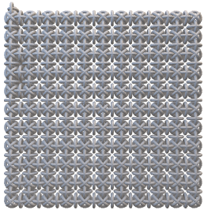


The Next STEPs
1
2
3
Cleaning
Consistency
Repetition

Slide 13
The final STEP: Predicted Features
Predict wing dimensions such as:
Span
Height
Length
For an aircraft given aircraft choices such as:
Type
Engine choice
Capacity
etc

Slide 14
THANK YOU

Slide 15
Summary
Do not include screenshots of code
The presentation must be that: a presentation (Don't show us your code and call it a day)
- The different locations on the internet that your script collects data from
- The layout of a example webpages you scraped and how you targeted elements within them
- In what format you chose to store your data and why (data lake vs data warehouse, file type, database table schema)
- How you cleaned the data (No imputation required now)
- Suggestions of which variable in your dataset you will attempt to predict using some of the remaining variables

